Slide 1
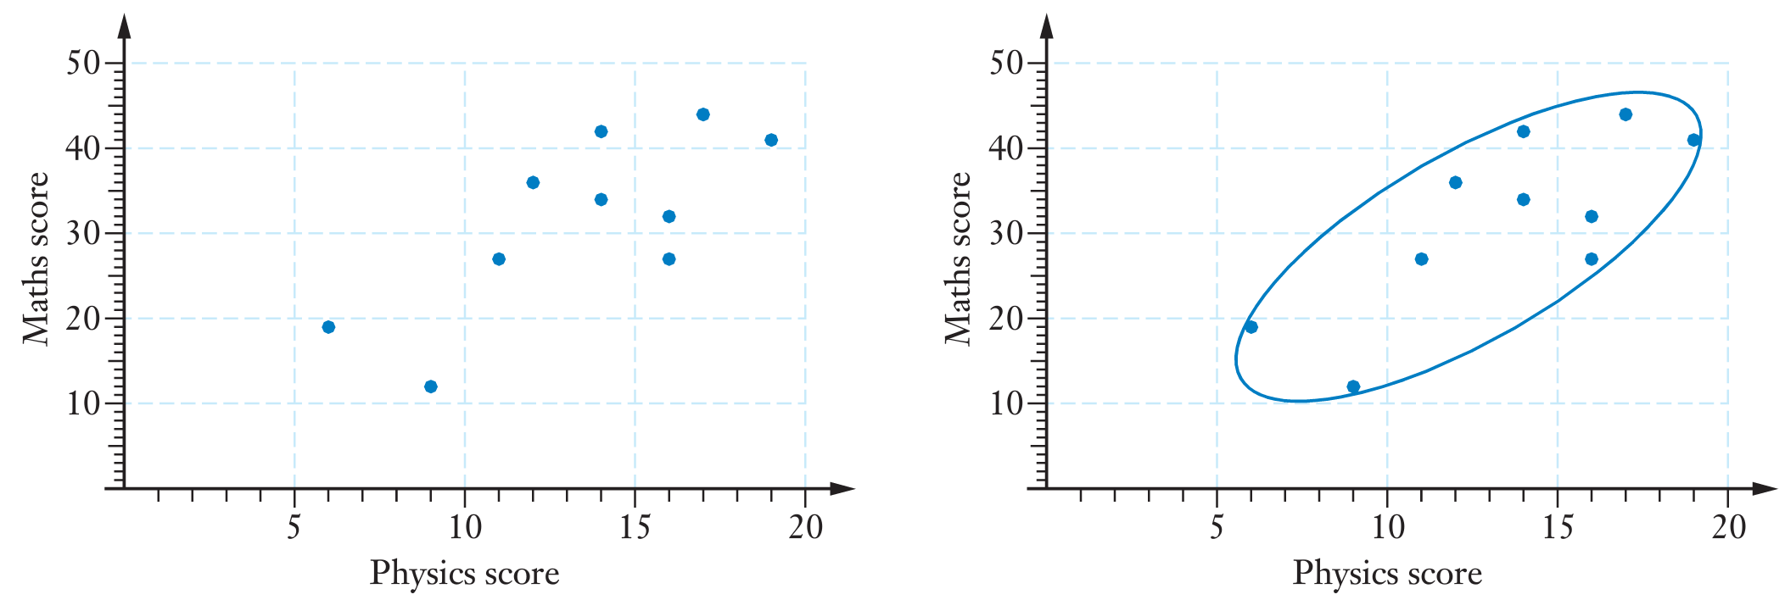
Topic: Bivariate Data – Further Analysis
EQ: What are some more advanced tools we can use to accurately describe the relationship between two variables?
In the previous chapter we investigated whether associations or correlations existed between two numerical variables. A scatter plot was used to suggest whether a linear, or some other, model would be useful. In this respect, we considered what form (linear/non-linear) any association might take. We now need to be more descriptive and quantitative about situations for which a linear model seems appropriate. Let’s look at the following:

Slide 2
We can say that the scattergraph suggests a positive correlation
As well as talking about the form of the relationship between the two variables, we can talk about the direction (positive or negative) of the relationship and and strength (strong, moderate, weak)

Slide 3
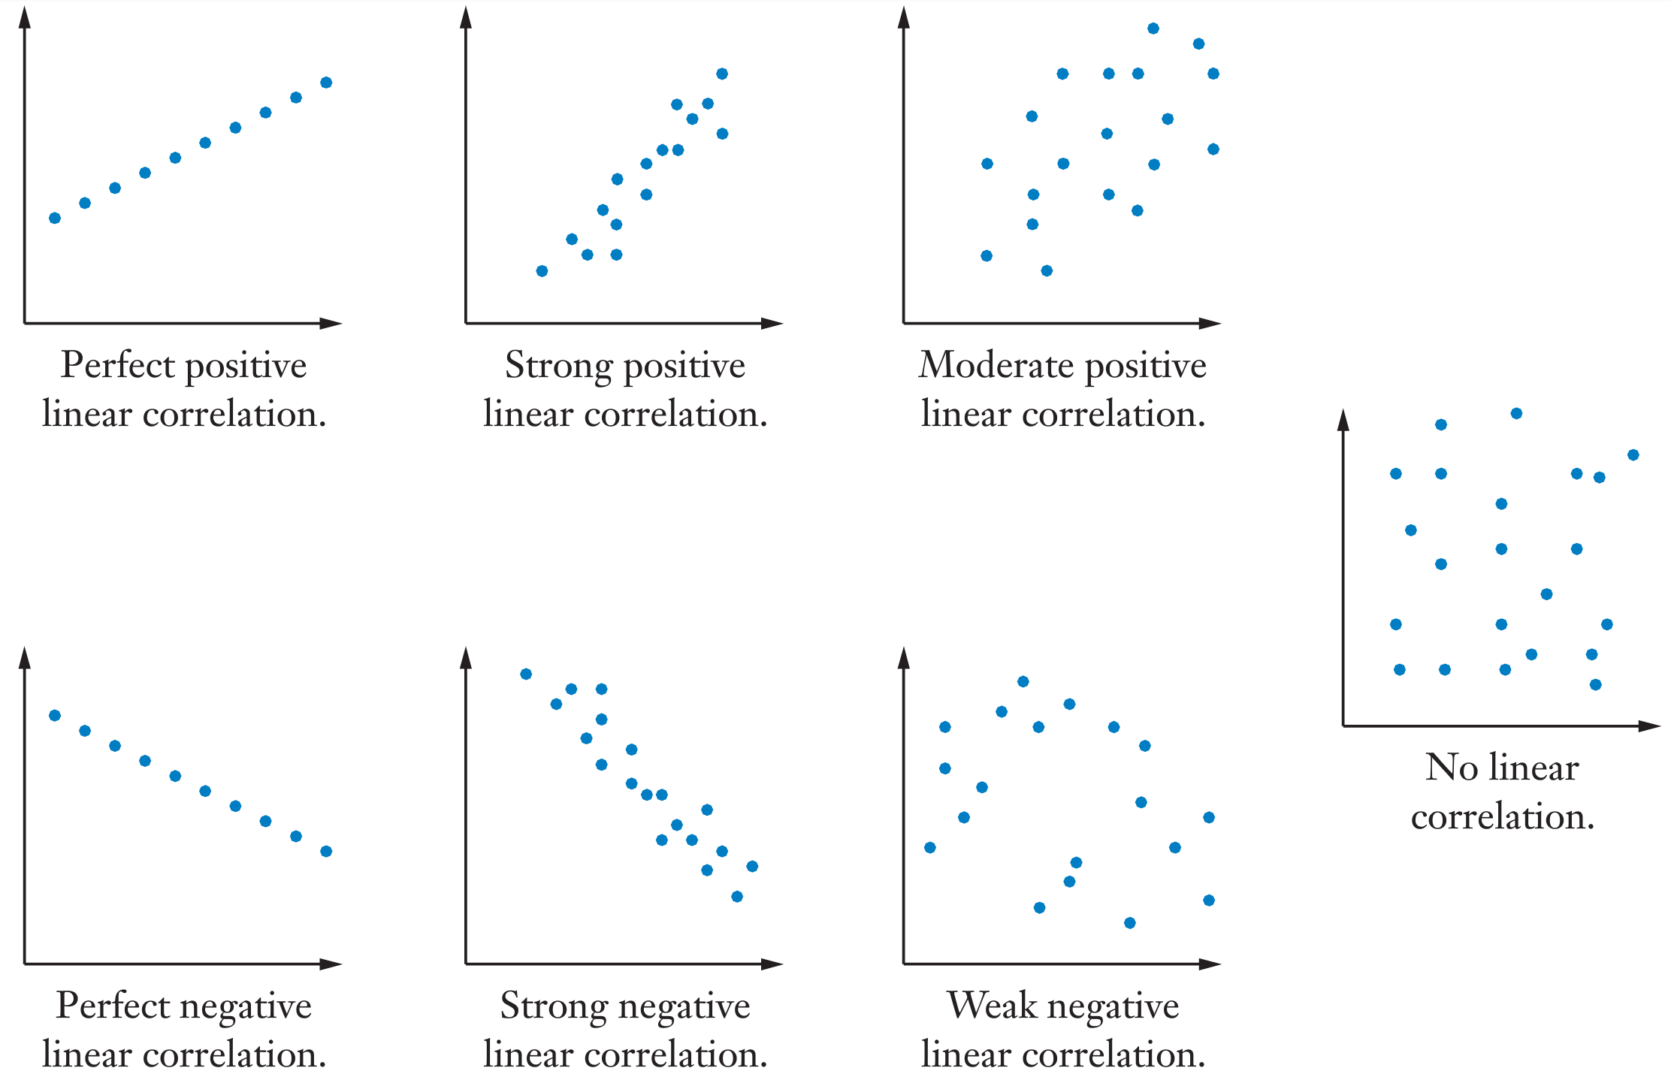

Slide 4
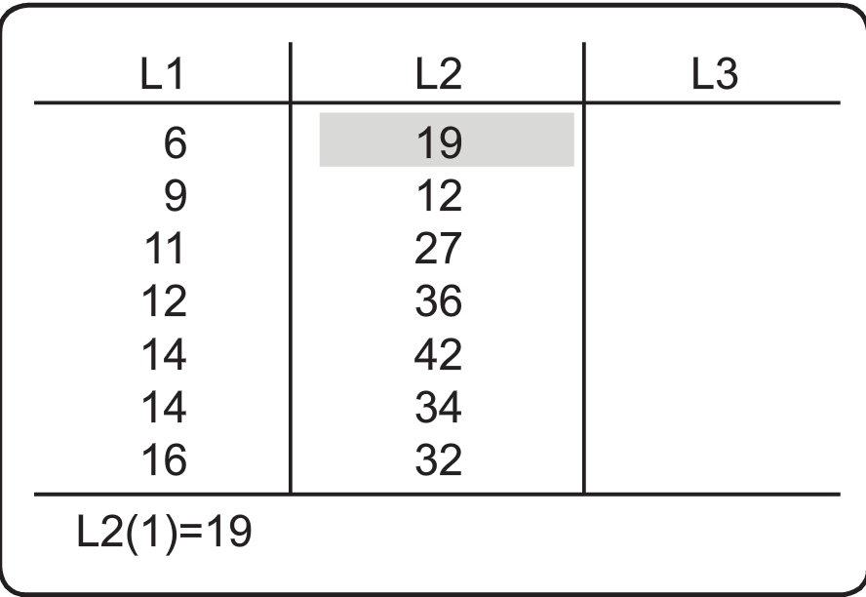
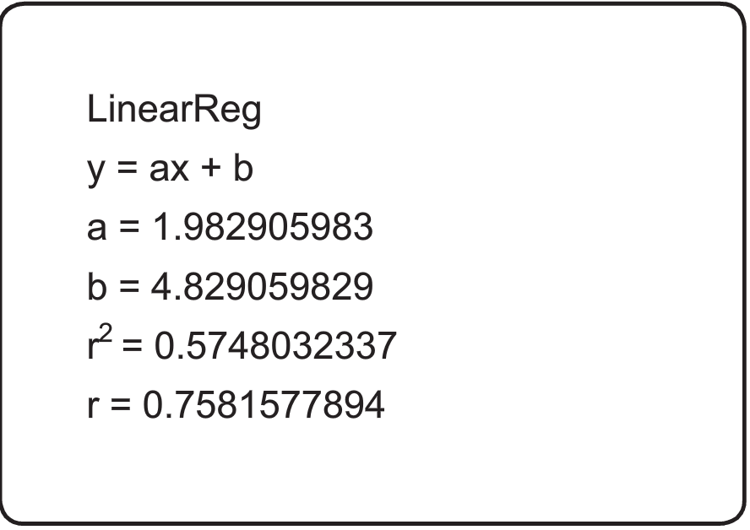
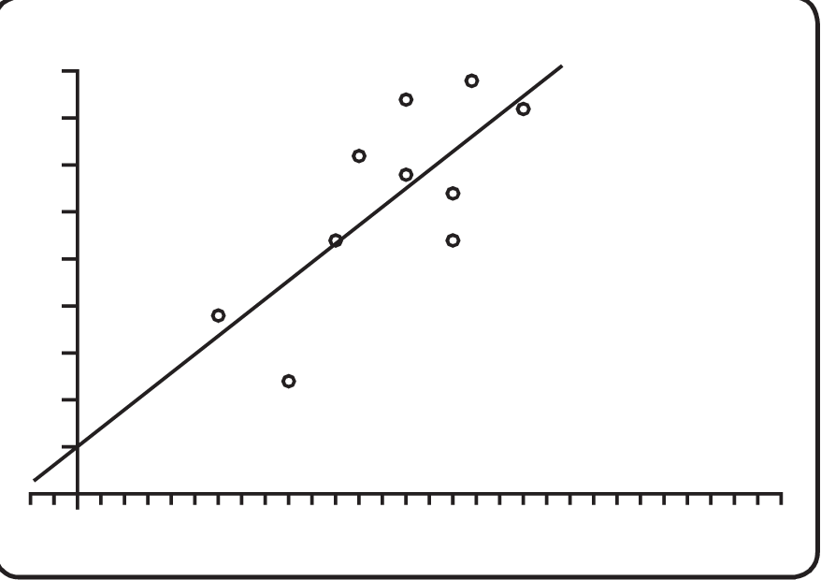
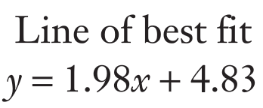
If we want to do better than eye-balling the line of best fit, we can use our ClassPad. Let’s look at a previous example:
When we enter these values into our ClassPad, we typically get this screen:
The calculator can then use linear regression to:
Output the equation of the line of best fit in the form y = mx + c where y is the maths score and x is the physics score (see below left)
Display the points and the line of best fit (see below right)
Use this line of best fit to predict a maths score based on a physics score of 13

Slide 5
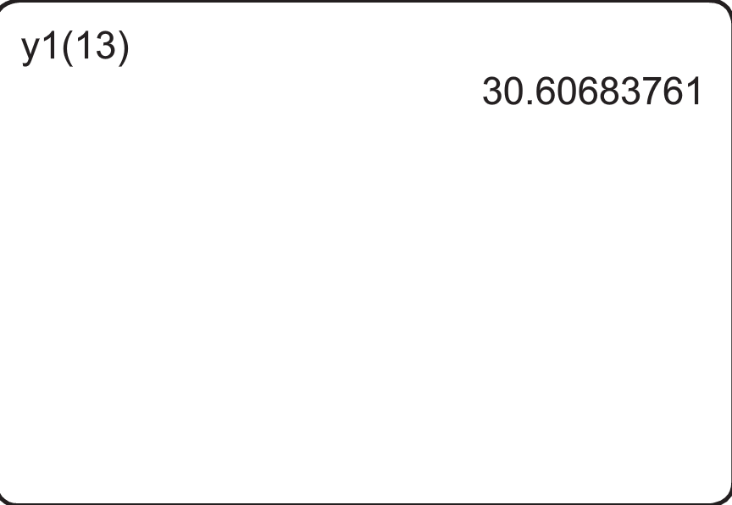
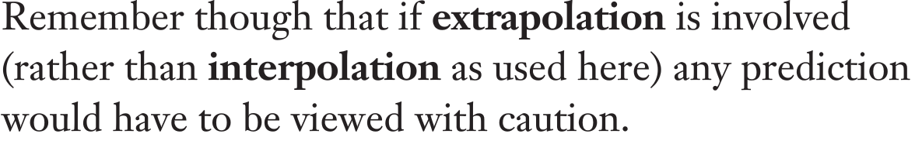
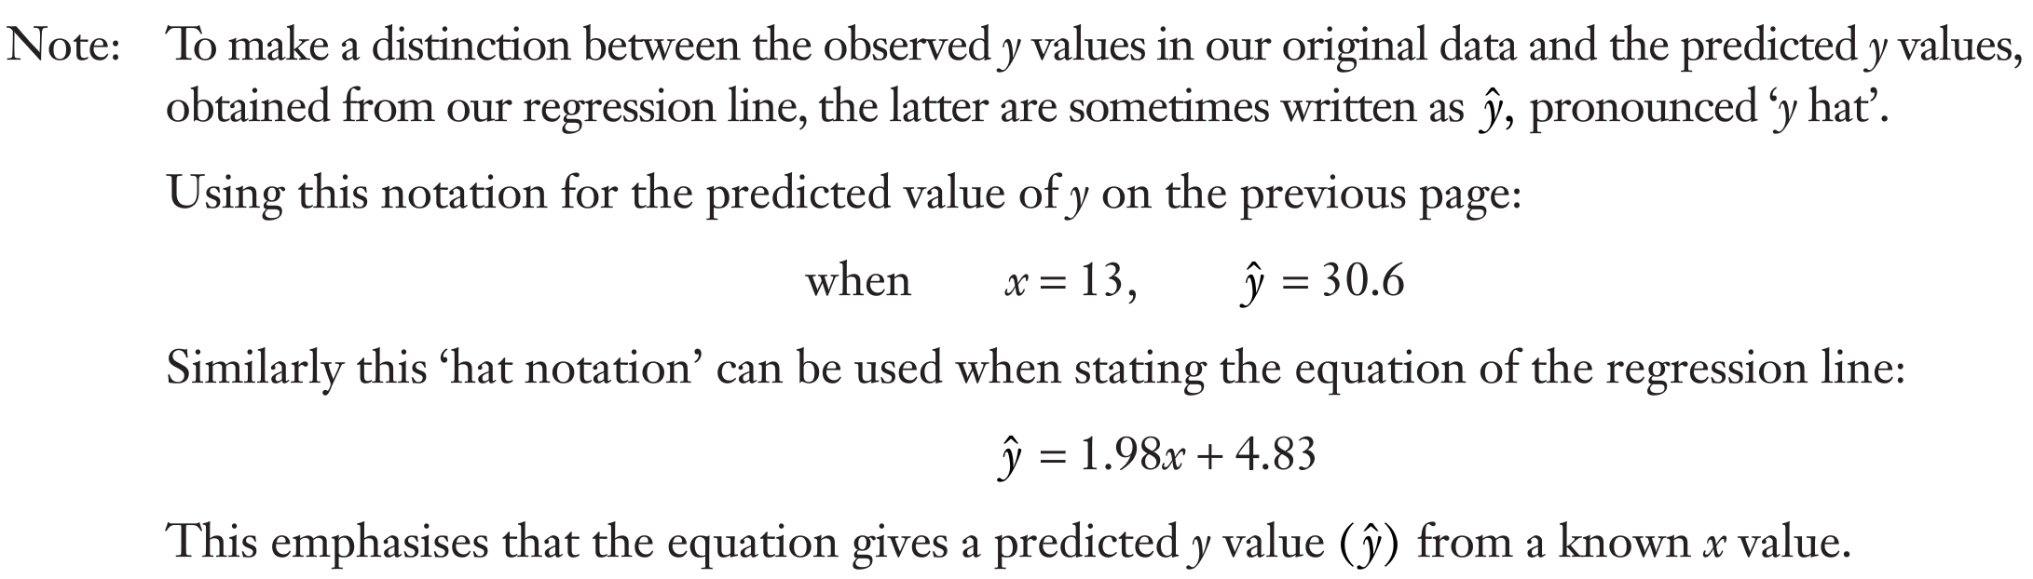

Slide 6
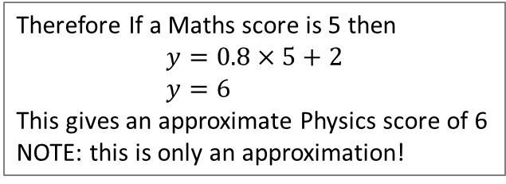
The relationship between the two variables can be depicted graphically in a presentation of the data called a scattergraph, as shown below in diagram 1:-
Each unit (in this case, a person) is represented by a point on the scattergraph. A dot represents the ordered pair (Xi, Yi) for the ith person.
As shown, a line could be drawn through these points and we can see that there is a linear relationship between the two variables X and Y. Many relationships are linear, and we shall be looking at the strengths of these linear relationships. We shall also be looking at an analytical way of calculating the “line of best fit” so that we may make predictions (both interpolations and extrapolations).
To find the equation of the line of best fit by “eye”, select two points on the line (near the “ends”). In the case above, select say (0, 2) and (10, 10)
Then gradient of line is 0.8, and y intercept is 2
Hence equation is y = 0.8x + 2
Therefore If a Maths score is 5 then
$$y=0.8×5+2 \\ y=6$$
This gives an approximate Physics score of 6
NOTE: this is only an approximation!

Slide 7
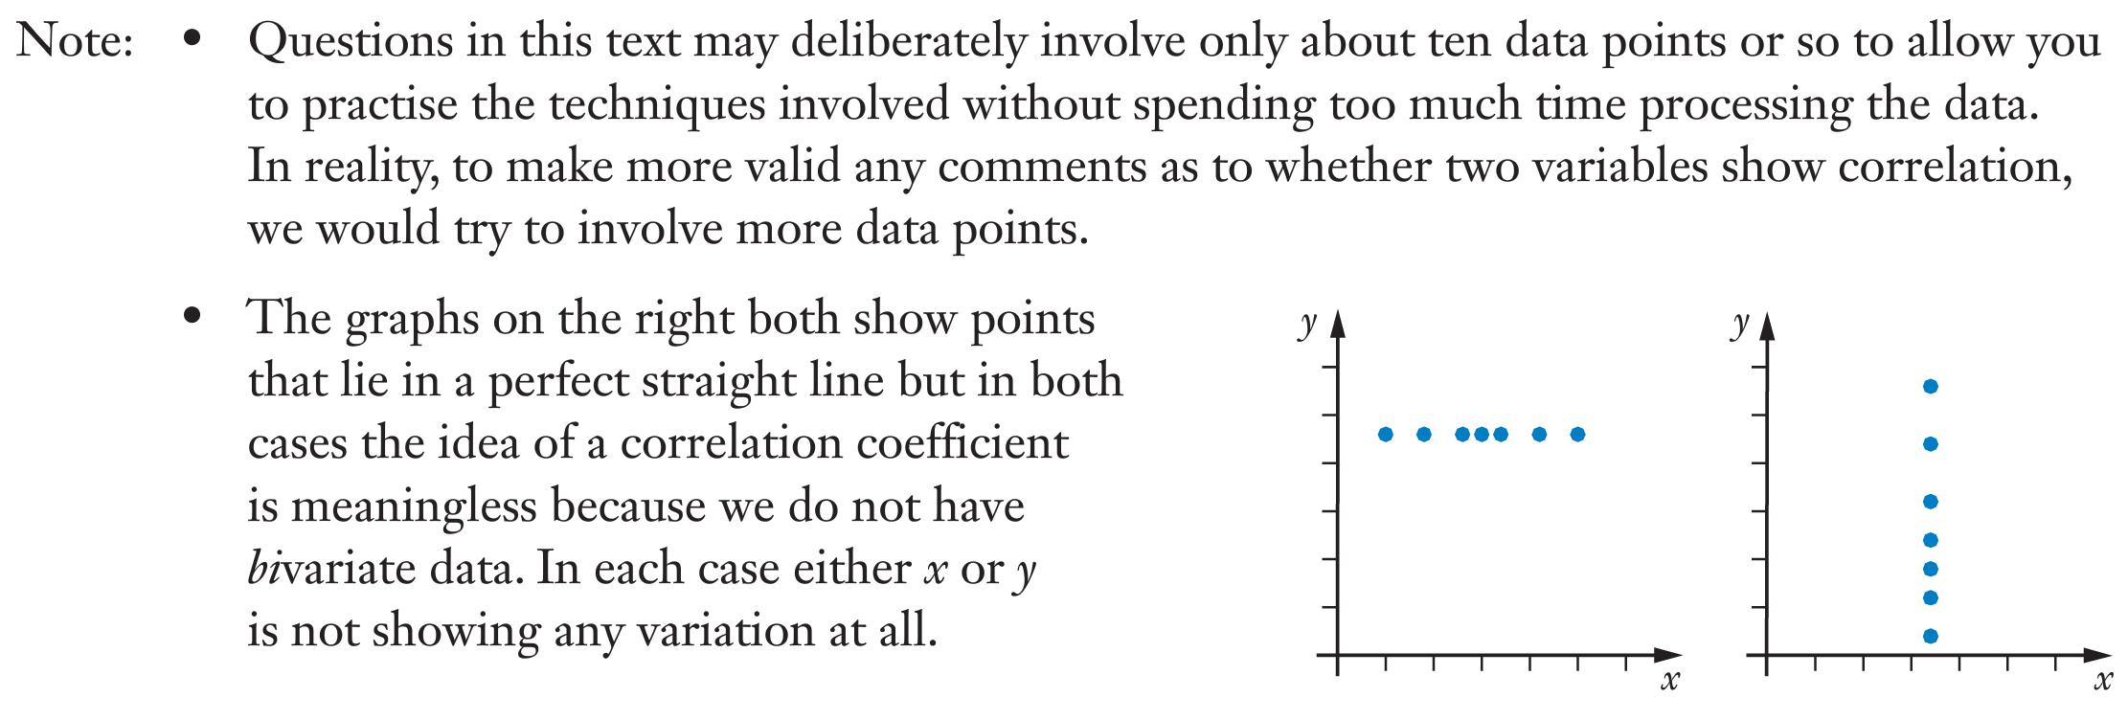
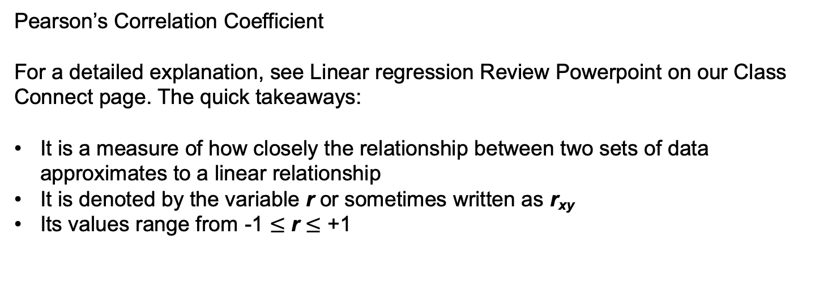
Pearson’s Correlation Coefficient
For a detailed explanation, see Linear regression Review Powerpoint on our Class Connect page. The quick takeaways:
It is a measure of how closely the relationship between two sets of data approximates to a linear relationship
It is denoted by the variable r or sometimes written as r_{xy}
Its values range from -1 $≤$ r $≤$ +1

Slide 8
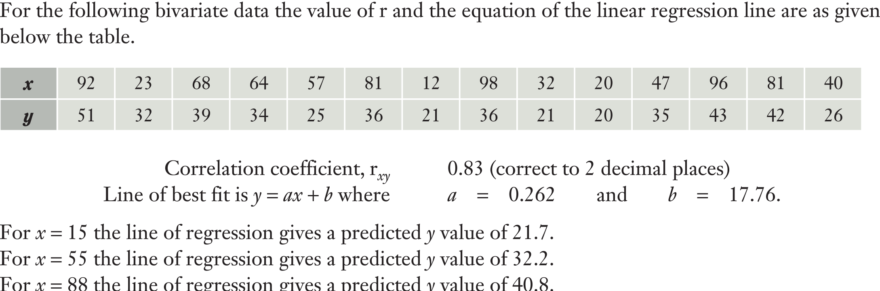
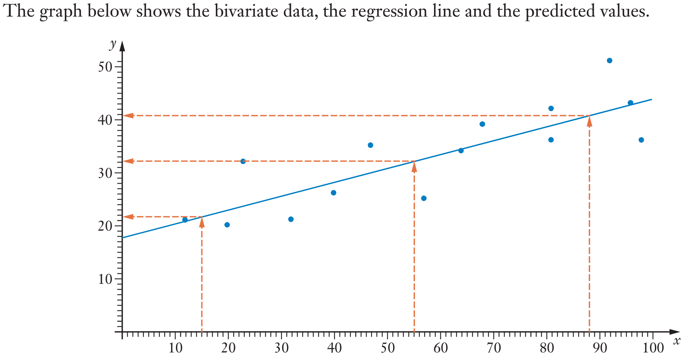
Can we have confidence in our predictions? Let’s look at an example

Slide 9
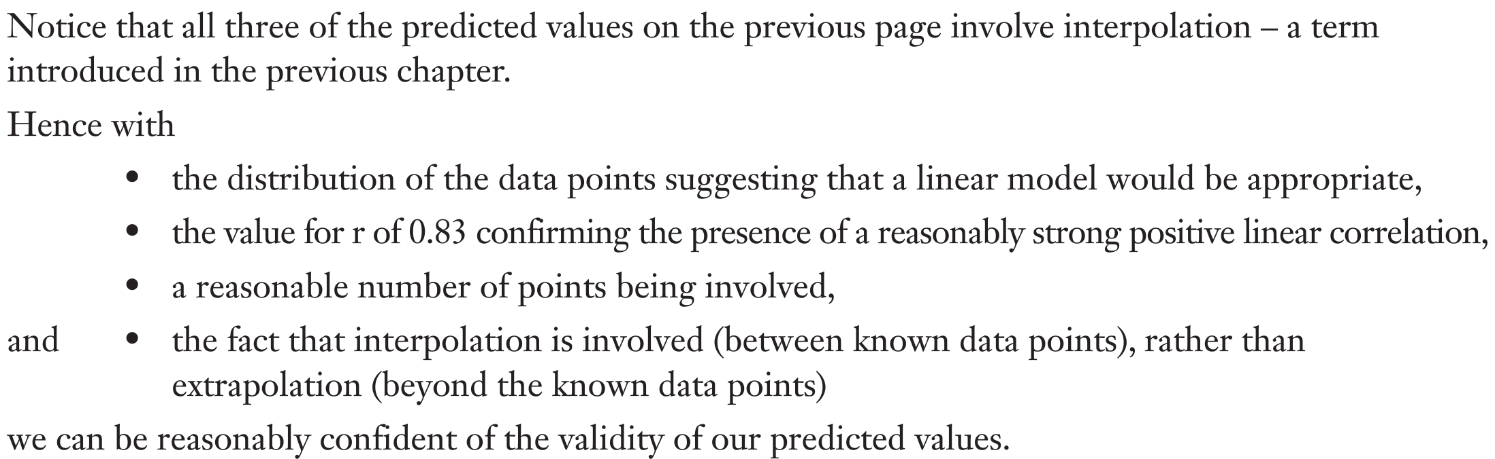
Can we have confidence in our predictions? Let’s look at an example

Slide 10
Can we have confidence in our predictions? Let’s look at an example

Slide 11
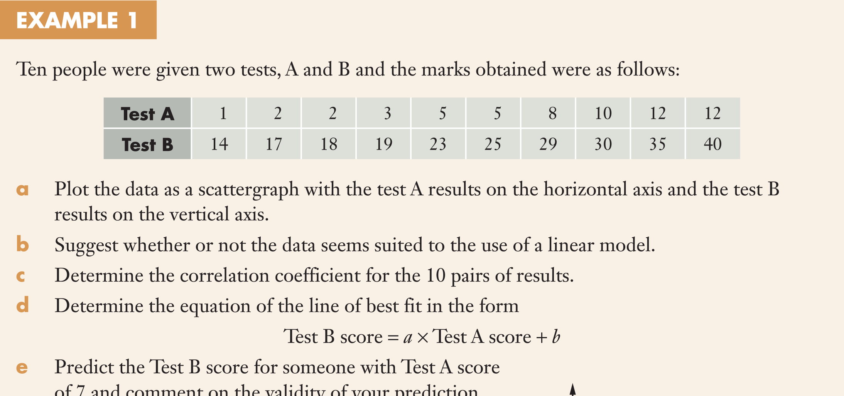
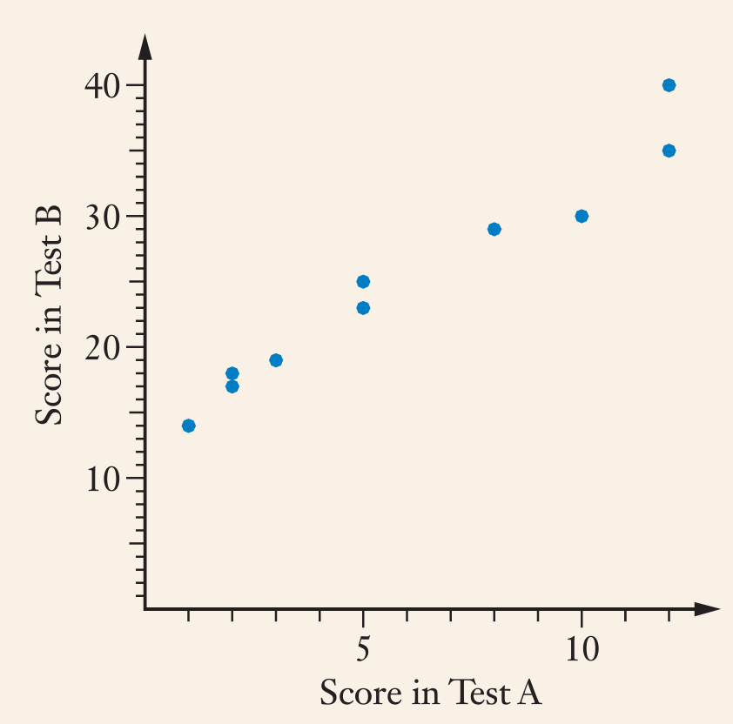
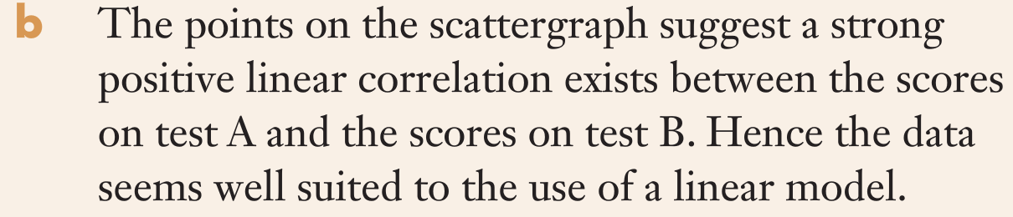
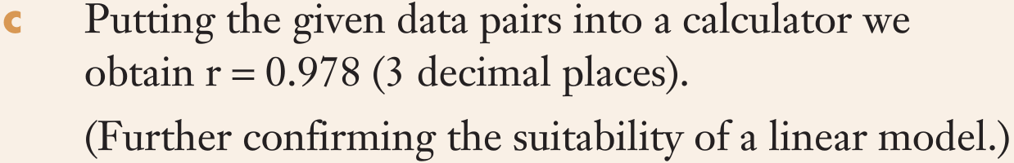
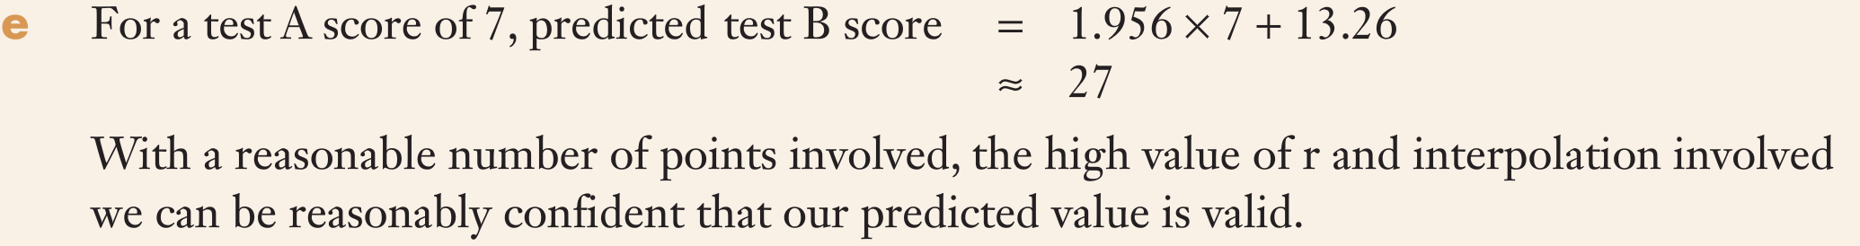

Slide 12
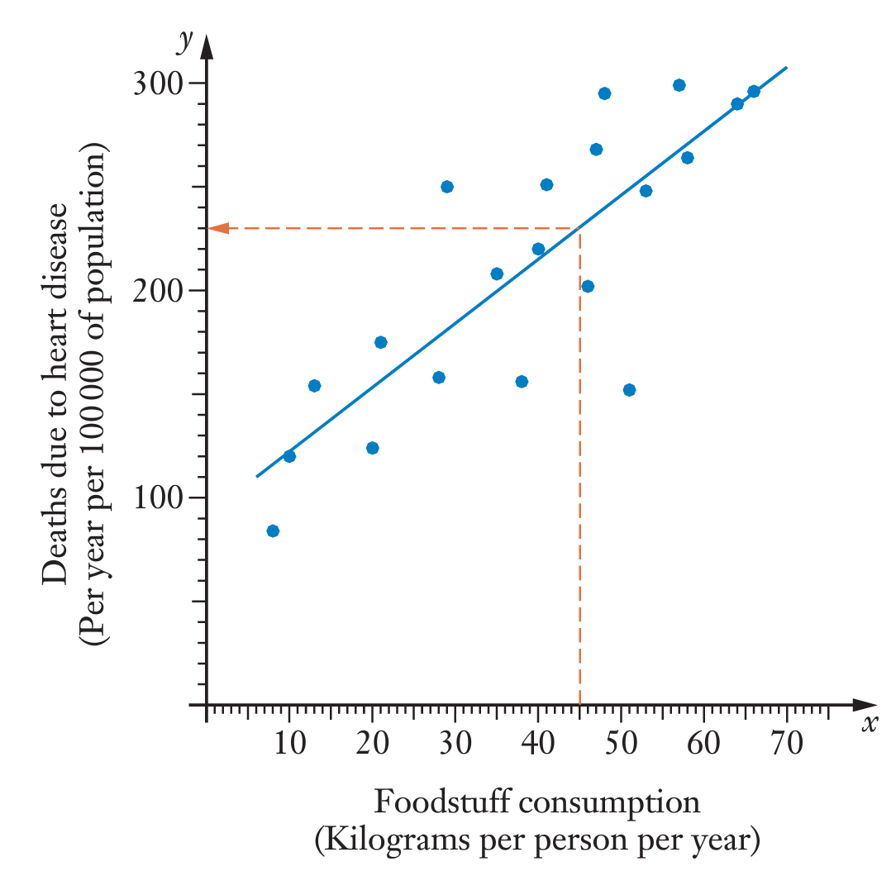
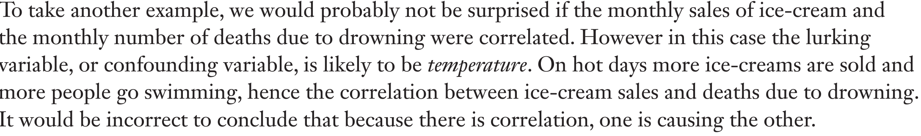
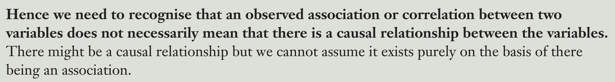
Cause and effect – Let’s have a look
Though a scattergraph, and accompanying r value, suggest a correlation between these two variables, we cannot assume that the changes in one variable cause the changes in another value.
There may be other variables, called lurking or confounding variables that each of our two variables could have a common response to. An example in tis case could be the affluence of the society in question.

Slide 13
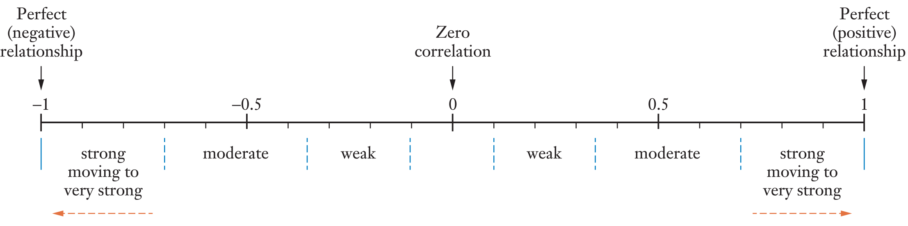
Pearson’s Correlation Coefficient and the line of best fit

